Slide 1

Integrations with Aida Software
Steinel
Somfy shade
Mecho Shade
Kisi

Slide 2
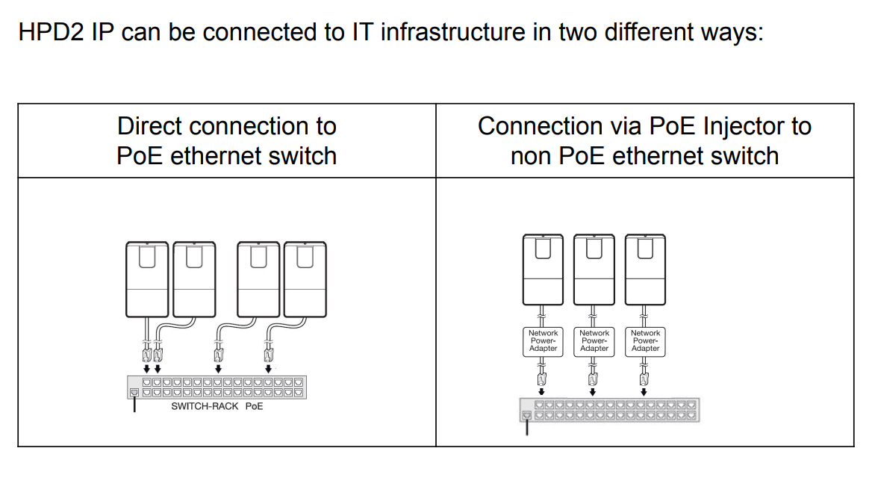
Steinel: Hardware setup and wiring diagram

Slide 3
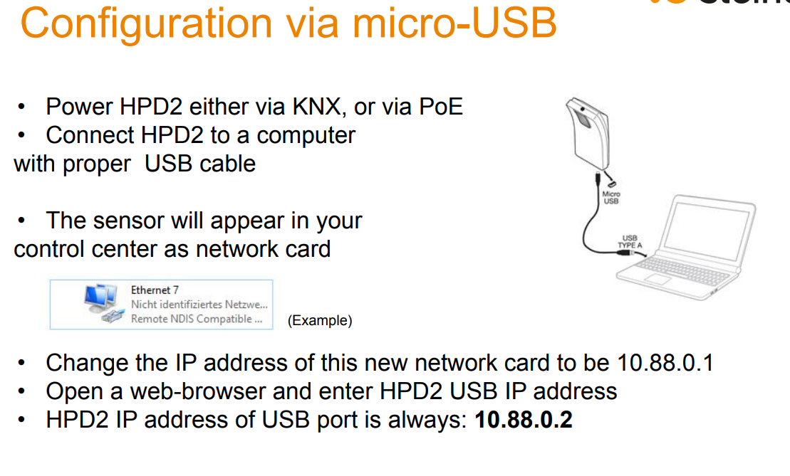
Steinel: Hardware setup and wiring diagram
The factory default password for first login is: adm123
Default password for live picture access is: steinel

Slide 4
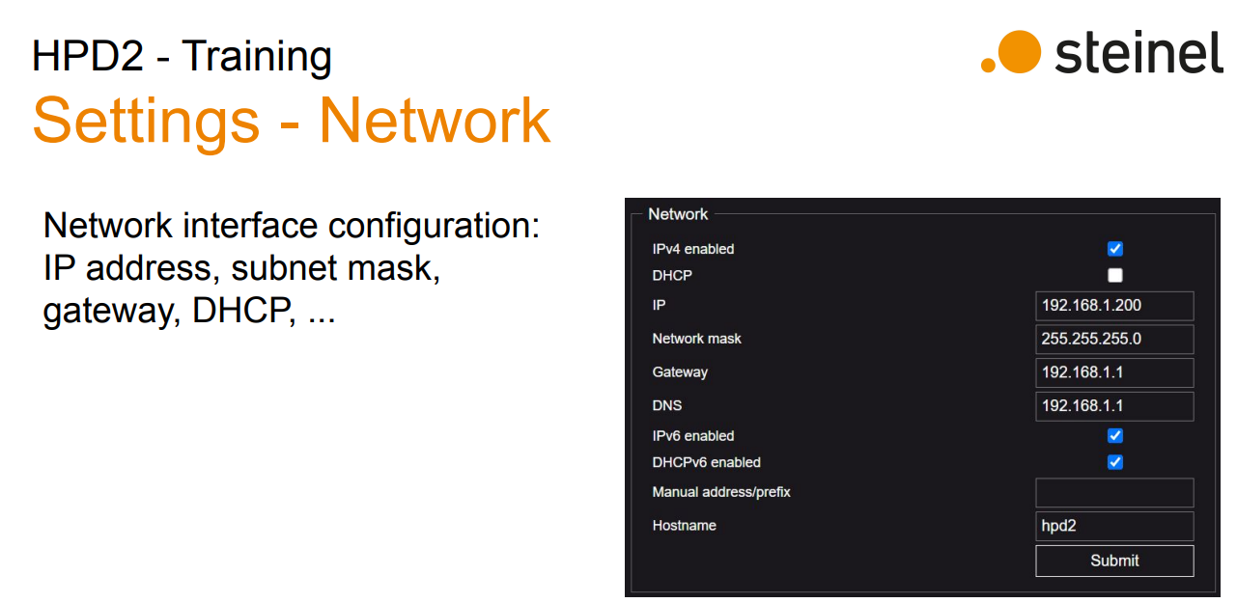
Steinel: Hardware setup and wiring diagram

Slide 5
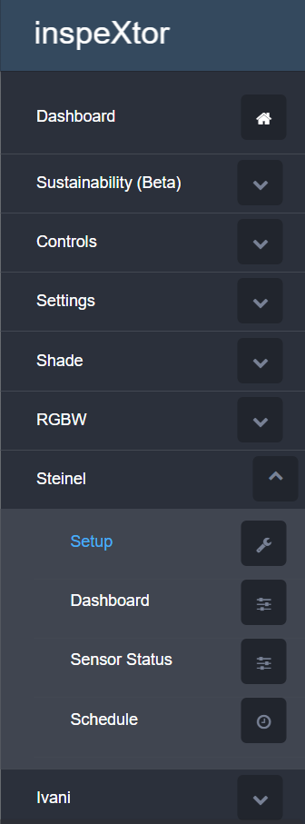
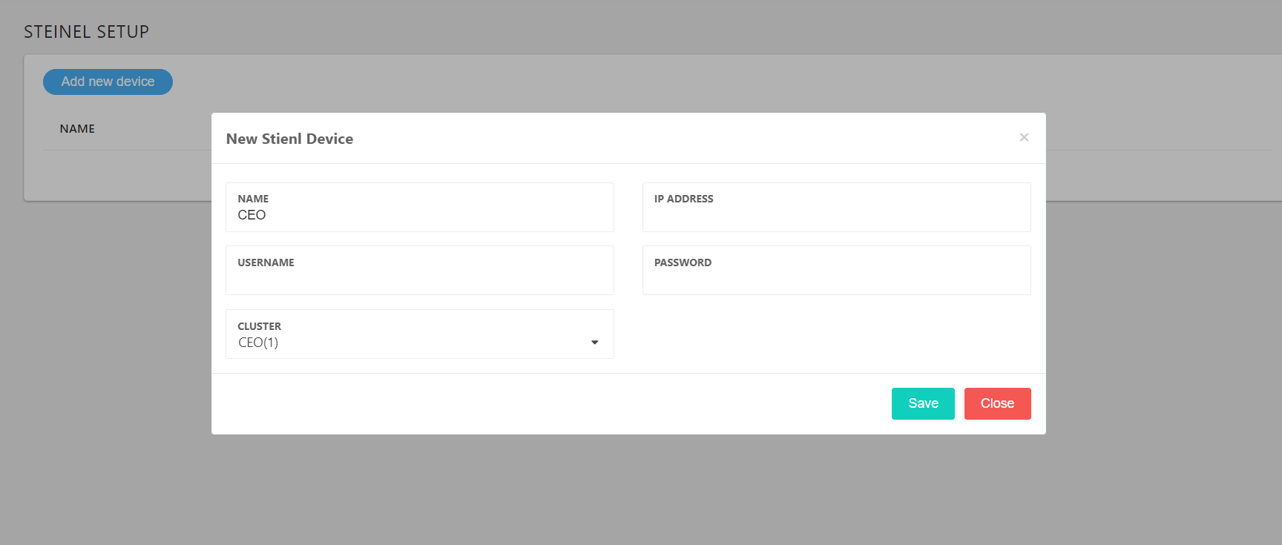
Discovery/setup

Slide 6
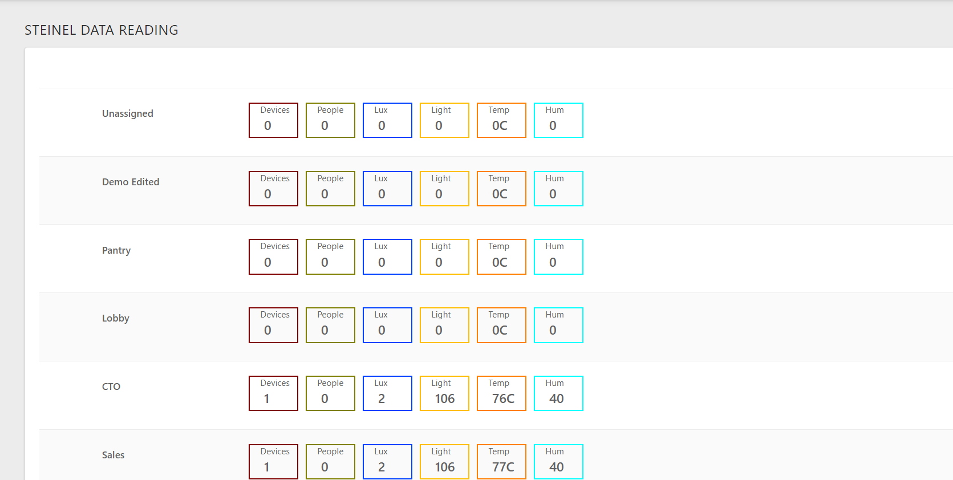
Control/Status

Slide 7
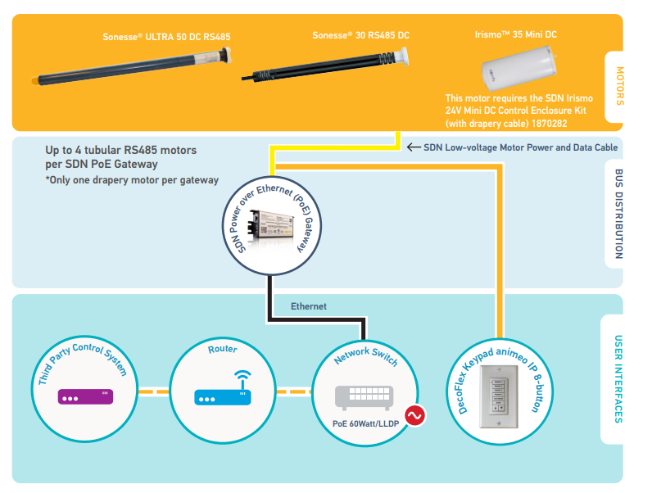
SOMFY: Hardware setup and wiring diagram

Slide 8
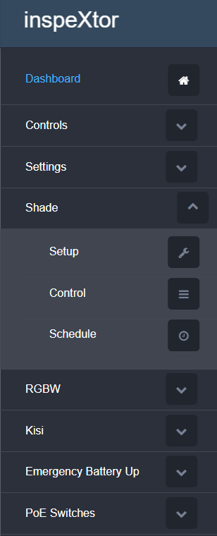
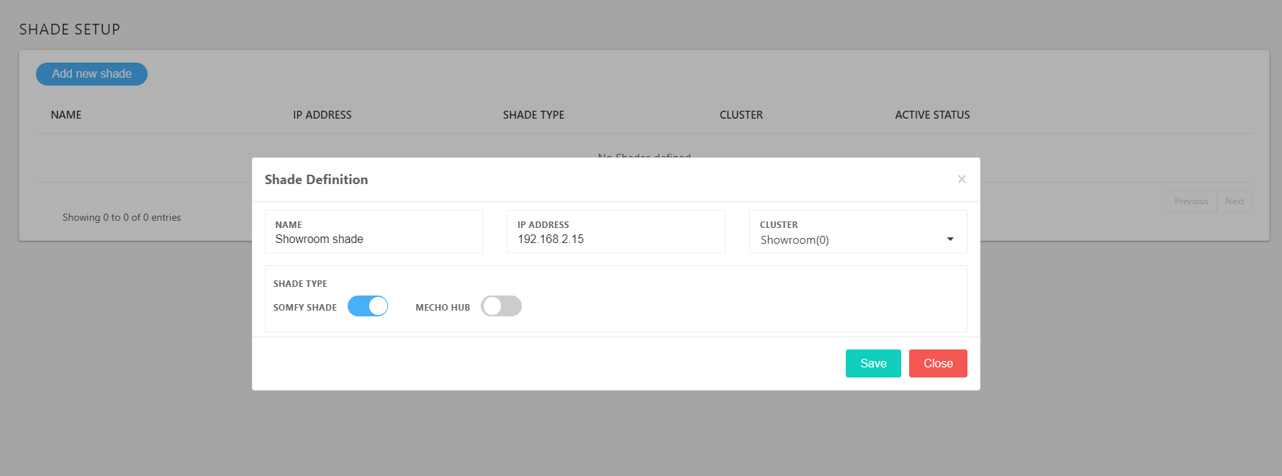
Discovery/Setup

Slide 9
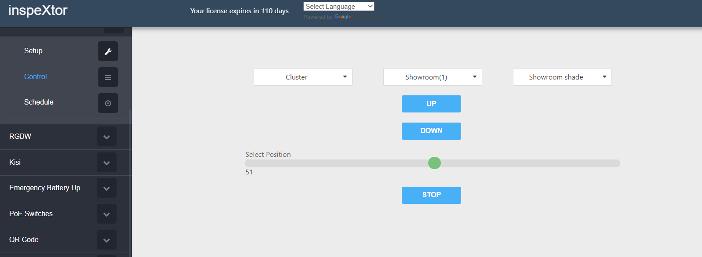
Discovery/Setup

Slide 10
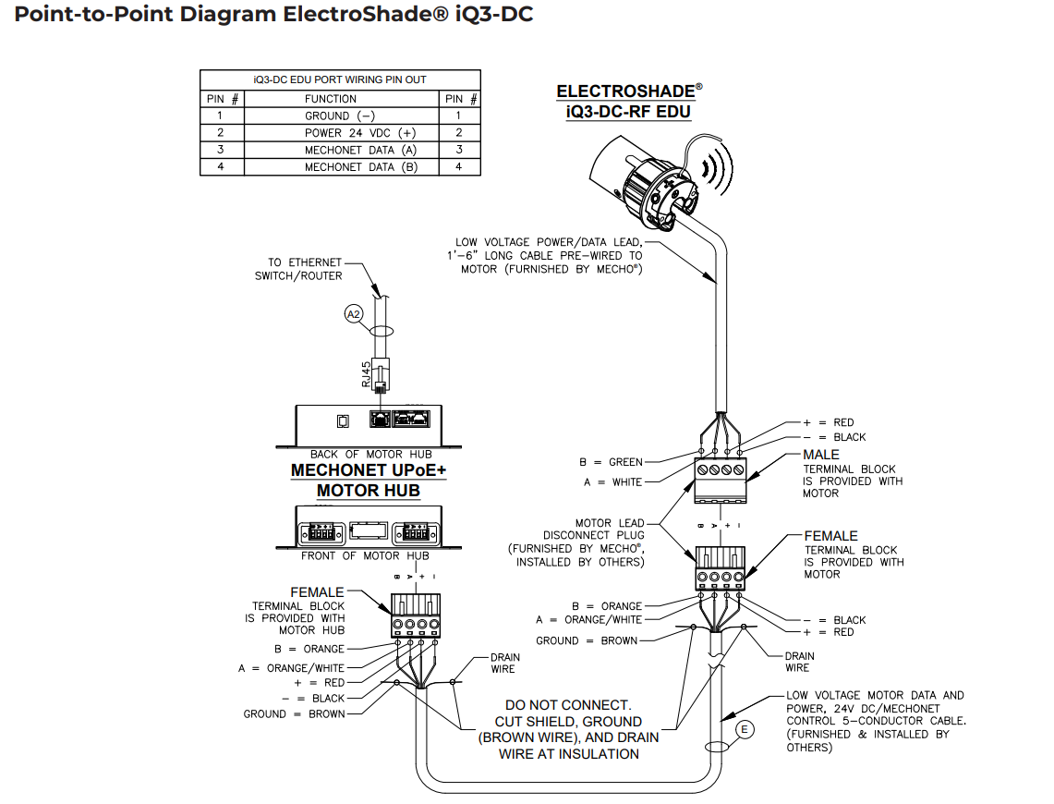
MECHO: Hardware setup and wiring diagram

Slide 11
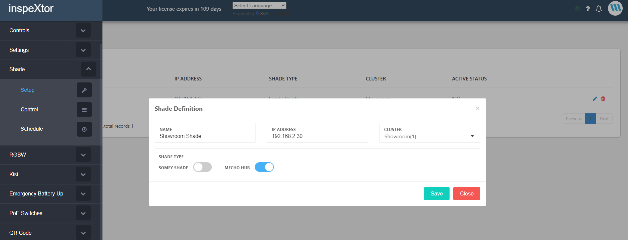
Discovery/Setup

Slide 12
Discovery/Setup

Slide 13
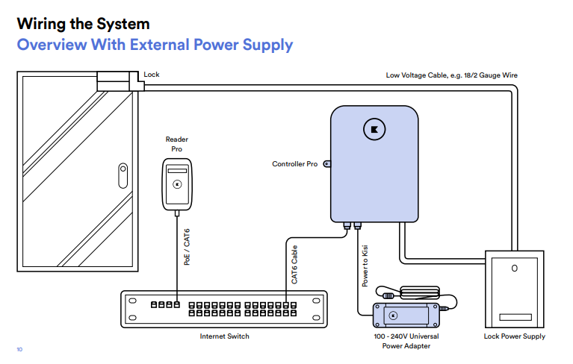
Kisi: Hardware setup and wiring diagram

Slide 14
Kisi: Hardware setup
create a place
create door
assign controller to place
assign controller to door
assign Reader to place
assign door to reader
create users/ Groups

Slide 15
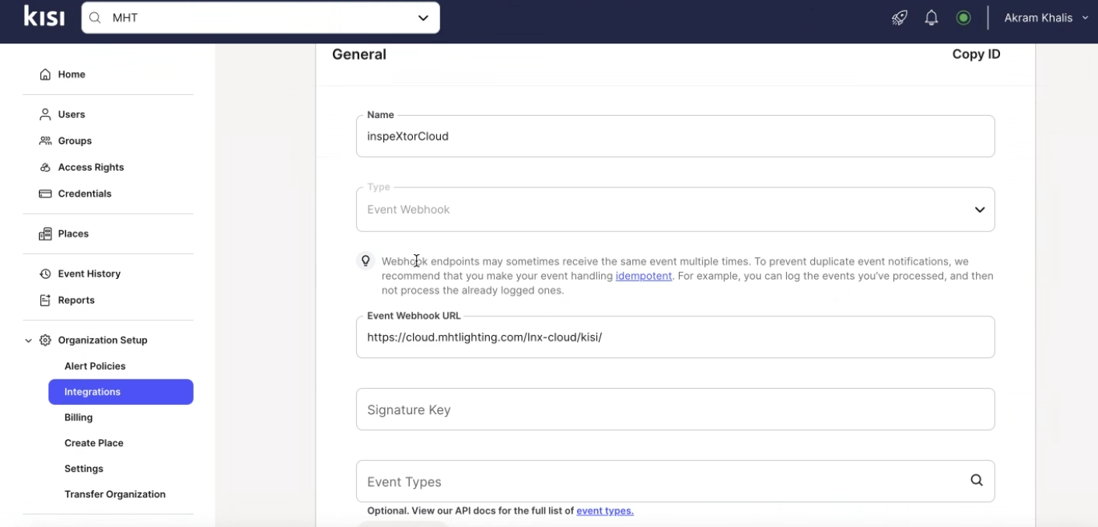
Kisi: Hardware setup
Make sure to have correct webhook URL in place

Slide 16
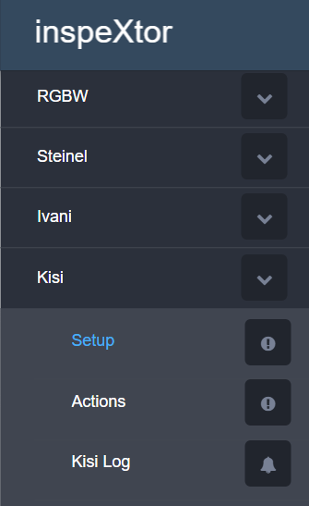
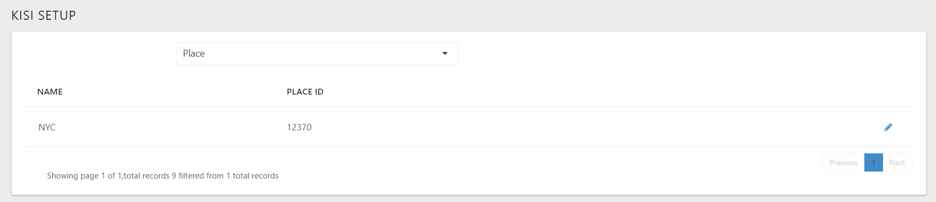
Discovery/Setup
Setup a Place by adding Place ID.
Place ID can be obtained from your Kisi admin account.

Slide 17
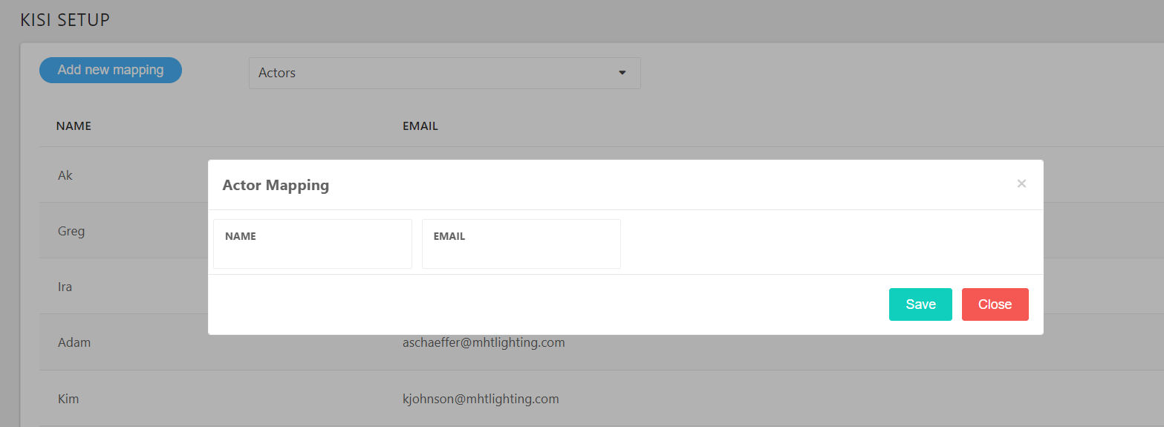
Discovery/Setup
Add kisi users by adding Name and email Id

Slide 18
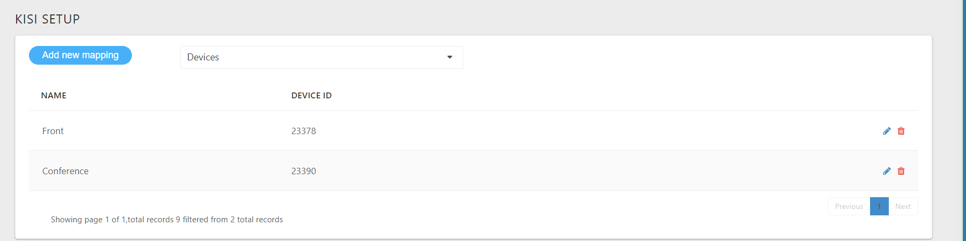
Discovery/Setup
Add kisi readers by adding Device Id
Device ID can be obtained from Kisi admin page

Slide 19
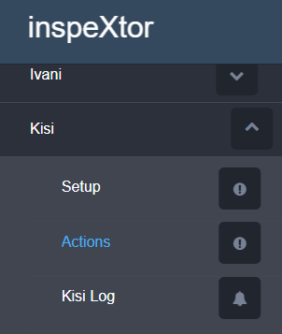
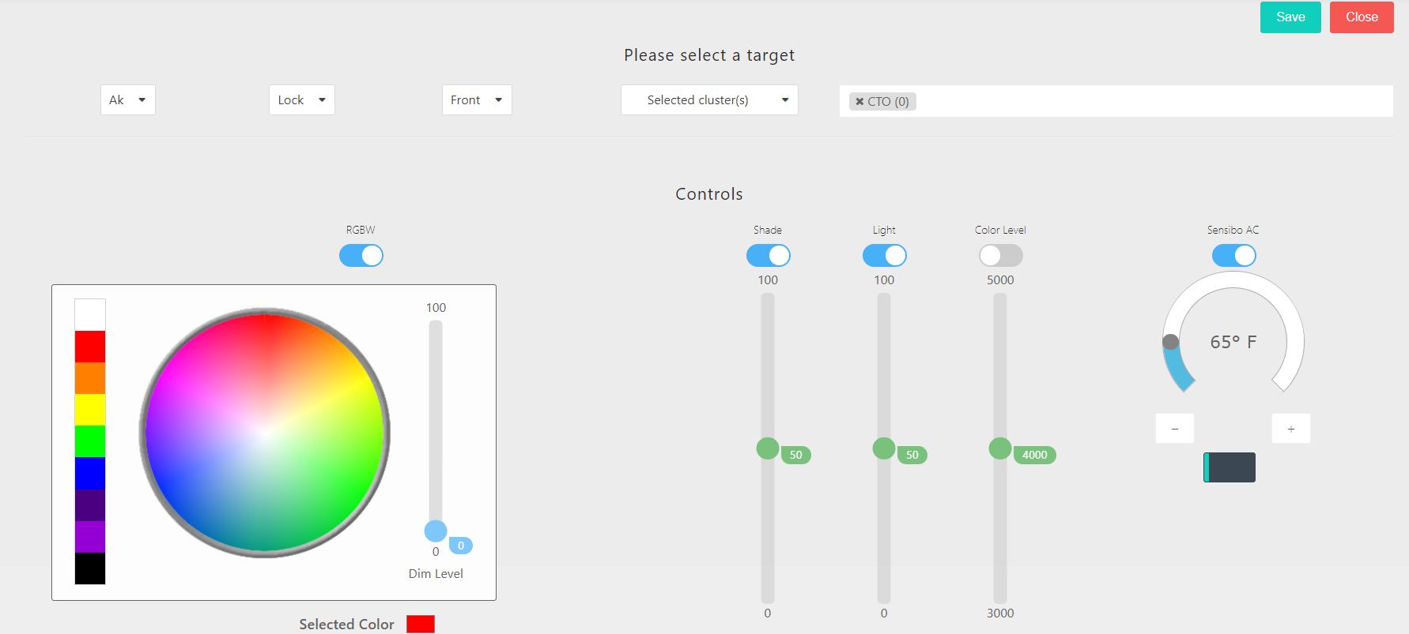
Discovery/Setup

Slide 20
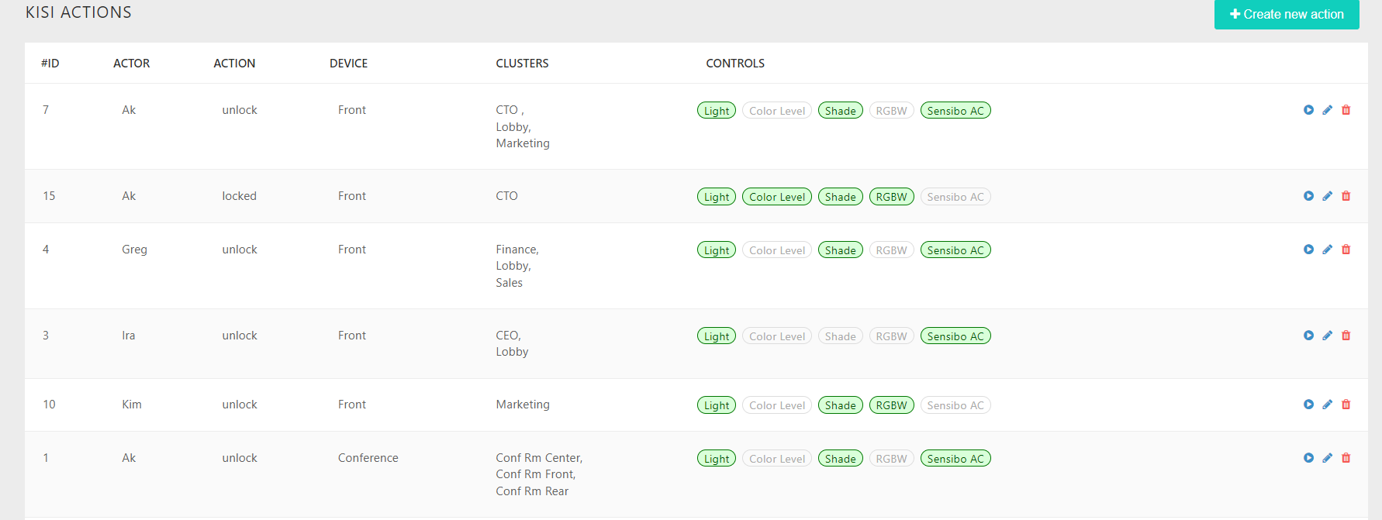
Discovery/Setup

Slide 21
Thank You
Presented by:
Harshal Bharambe
Network Engineer, MHT Technologies

